Slide 1
Asteroidal Occultations: Profiles, 3D-Models, discoveries, and data archiving
Dave Herald

Slide 2
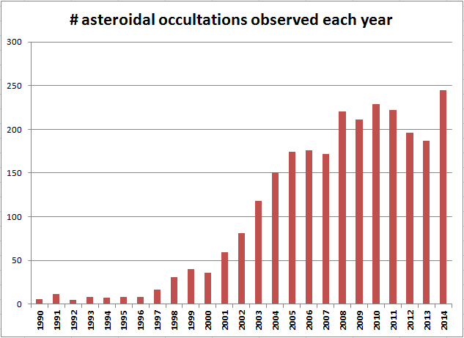
2014 best year ever - trend of previous 3 years reversed
About 200 events each year

Slide 3
Number of successful events by region, and max # sites: 2014/01 2014/12
Australasia 59 ( 8 sites)
Europe 79 (45 sites)
Japan 24 (16 sites)
US 79 (17 sites)

Slide 4
Discoveries from asteroidal occultations
moons of asteroids
new double stars
Rings around (10199) Chariklo

Slide 5
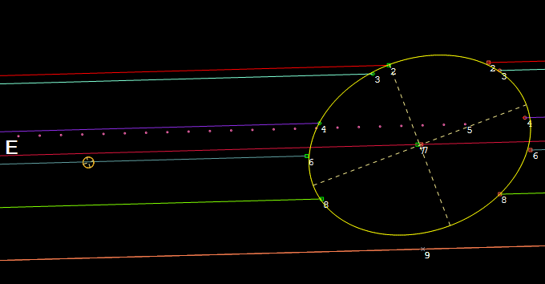
Satellite discovery #1 Agamemnom – 2012 Jan 19

Slide 6
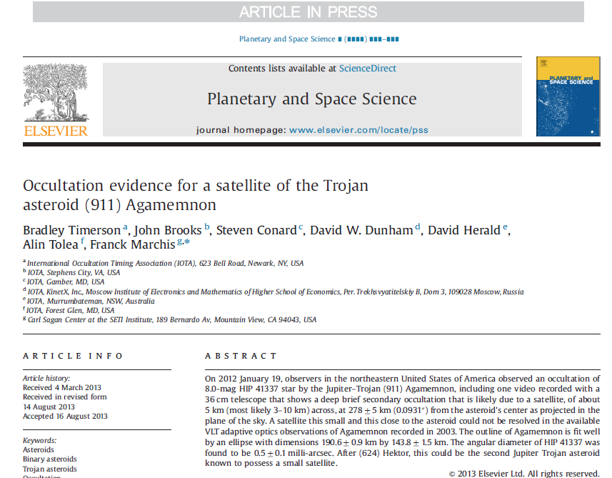
Paper in major astronomical journal

Slide 7
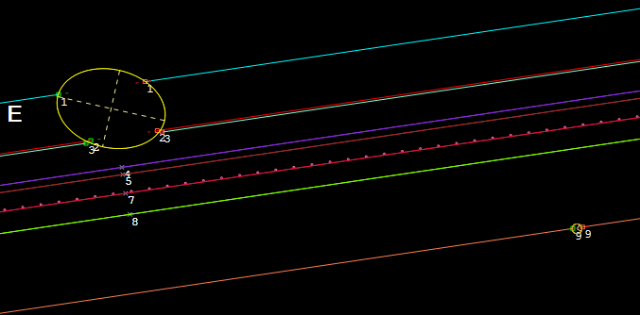
Satellite discovery #2 (2258) Viipuri – 2013 Aug 3 (?? - single integrated frame event)

Slide 8
Double stars discovered in asteroidal occultations
New double stars can be discovered in an asteroidal occultation
Separations are usually in the range 0.1” to 0.001”
If several observers, the uncertainty in separation can be less than 1 milli-arcsecond [ <0.001”]

Slide 9
12 double stars discovered since Jan 2013
Star number Sep (mas) P.A. Date Asteroid
1856-00745-1 603.0 100.1 2013 Jan 6 87 Sylvia
2U46691743 43.0 ± 0.6 237.0 ± 1.2 2013 Jan 27 536 Merapi
1950-00148-1 28.3 ± 0.4 12.3 ± 0.8 2013 Feb 6 92 Undina
6258-00144-2 1.3 ± 0.5 242.3 ±25.4 2013 Jul 24 1271 Isergina
6828-01457-1 88.7 255.5 2013 Aug 3 2258 Viipuri
2U30429828 380.0 240.0 2013 Aug 15 611 Valeria
7444-01434-1 31.2 -67.6 2013 Aug 15 481 Emita
4UC602-035724 23.0 -103.0 2013 Oct 5 120 Lachesis
0646-00730-1 247.0 265.7 2013 Oct 21 617 Patroclus
1950-02320-1 152.9 ± 0.8 105.8 ± 0.7 2013 Dec 28 141 Lumen
0801-01593-1 1.2 -67.7 2014 Jan 18 664 Judith
5227-00026-1 3.0 2.0 2014 Dec 9 3950 Yoshida

Slide 10
Valeria - 2013 Aug 15 Wide double star (380mas) Time diff: 66 secs Chris Chad, Gunnedah

Slide 11
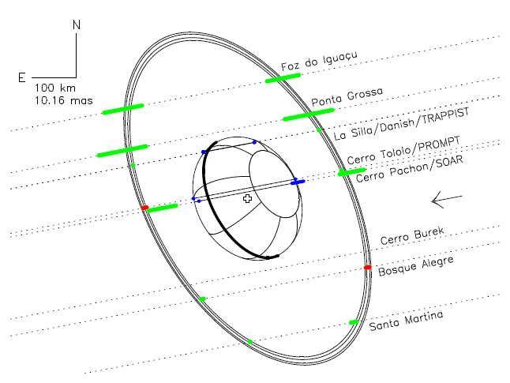
Rings around (10199) Chariklo
Discovery - 2013 June 3
1982
1986
1997
2007
2014
Ring radii: 390.6±3.3 km; 404.8±3.3 km
2018

Slide 12
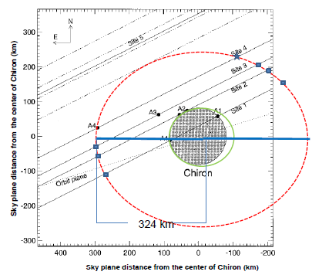
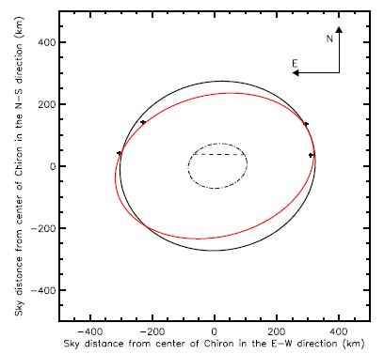
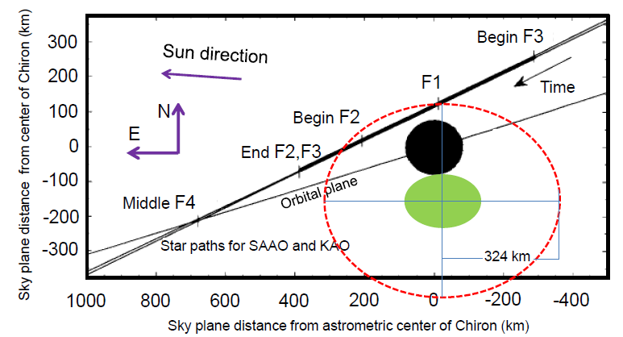
Ring around (2060) Chiron ??
Possible detections
1993
2011
1980
1990
2000
1994
2007
Ring radius:
324 ±10 km
2015
2023

Slide 13
Light curve inversion
Irregular shape causes rotational light curve variation
When polar axis is inclined to the ecliptic, the parts of the asteroid that are ‘visible’ varies, depending on location in orbit
Can model the shape of the asteroid using the differing light curves – called ‘inversion models’

Slide 14
Requires accurate measurement of the rotation period, and determination of the direction of the axis of rotation
The model gives a shape for the asteroid, but not its size
Most models currently are limited to convex surfaces
Usually two models fit the available data

Slide 15
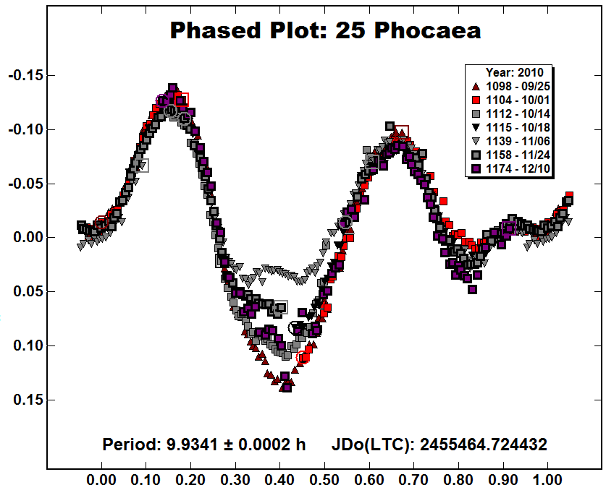
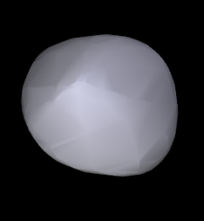
Light curve analysis
3D model

Slide 16
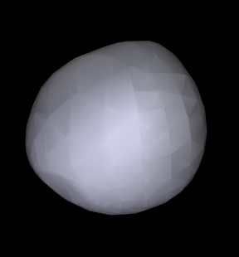
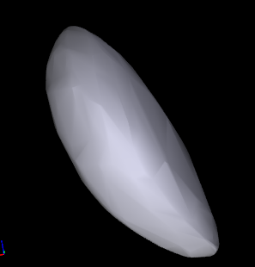
Some other shape models
Pallas
Geographos

Slide 17
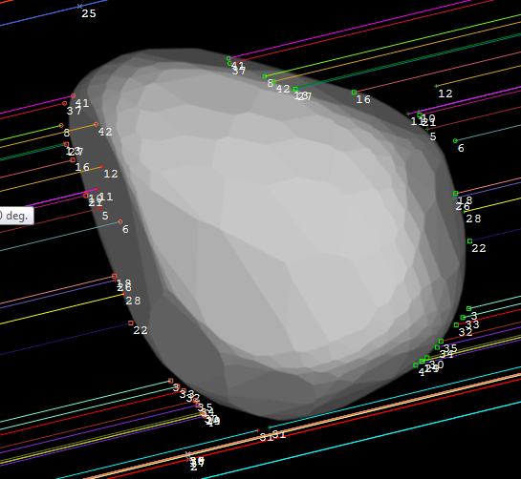
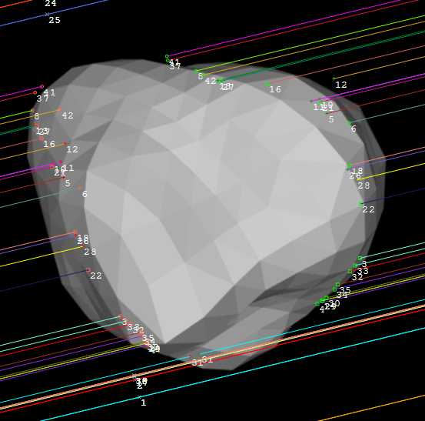
Eliminate models
(9) Metis 2014 Mar 7
Model 1 ✓
Model 2 ✗

Slide 18
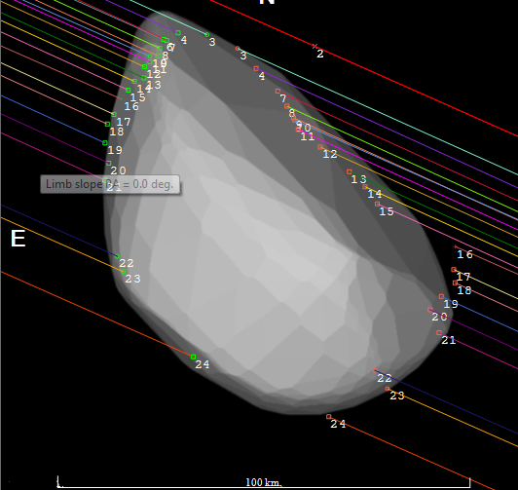
Precise dimensions
(135) Hertha 2008 Dec 11

Slide 19
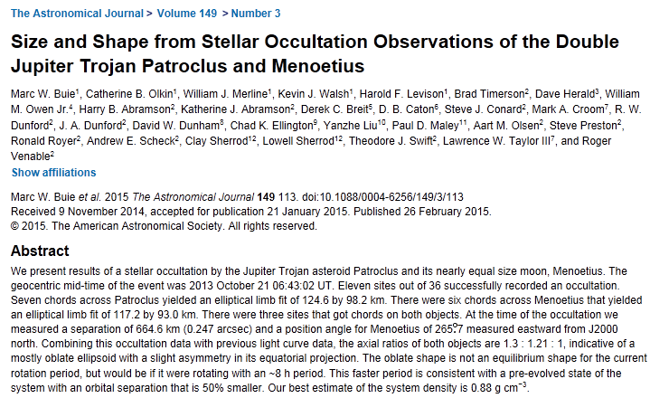
Paper in Astronomical Journal

Slide 20
Reporting & Archiving observations
Currently over 2,700 asteroidal occultation events observed,
12600 observations (many of which were miss observations)
Average of 5 observers per event

Slide 21
Data collection
World divided into 4 main observing regions
Australasia
Europe
Japan
North America

Slide 22
Regional coordinators
Observers send observations to a ‘regional coordinator’ for their region, who:
collates the observations into a single file;
Checks the data for consistency/errors etc
Publishes results on a ‘local’ web site
Forwards the observations to a Global Coordinator
John Talbot is the coordinator for Australia & New Zealand

Slide 23
Global coordinator
Keeps an eye out for problem observations
Adds the observations to a consolidated file
Makes the updated file available to all users of Occult (global data backup!)
Periodically sends a report of astrometry derived from occultations to the Minor Planet Centre – with all associated observers being named, and included in the SAO/NASA ADS [Astronomical Data System]

Slide 24
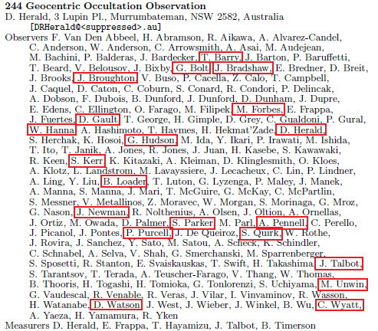
Sample astrometry report
List of observers (Aus/NZ highlighted)

Slide 25
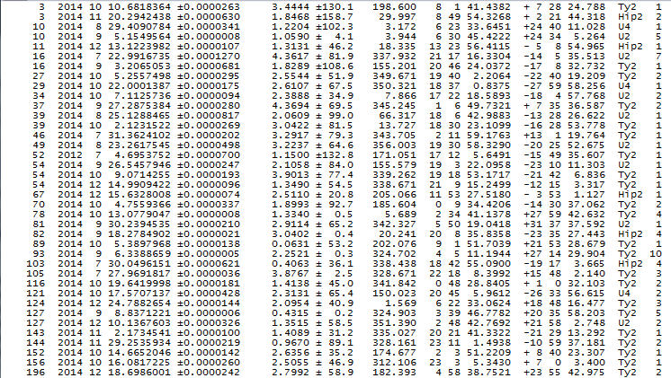
Sample astrometry report
Astrometric positions

Slide 26
Example publication of astrometry

Slide 27
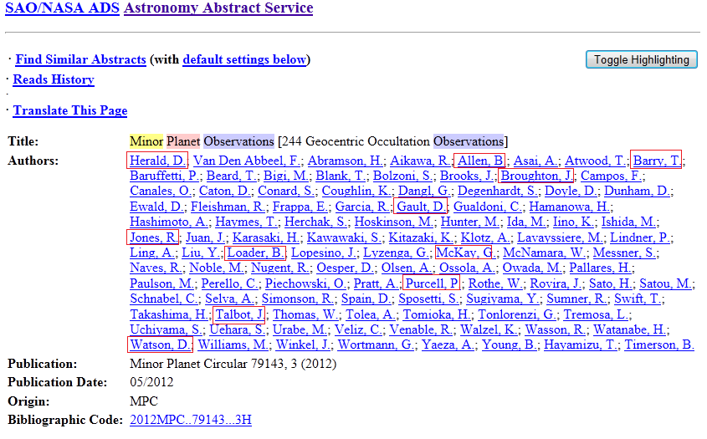
Example ADS entry

Slide 28
Archiving at NASA’s Planetary Data System [PDS]
All observations archived each March at PDS – small bodies node
Data has to be reformatted to meet PDS formatting requirements (Numeric data fields must have a character at each location in the field)
Dataset goes through a comprehensive review process

Slide 29
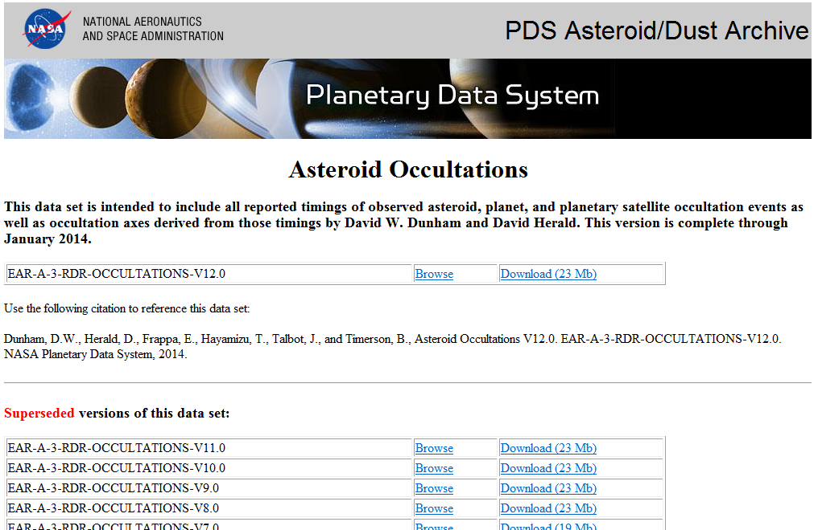
http://sbn.psi.edu/pds/resource/occ.html

Slide 30
Any questions?

